Slide 1
Weapons of math destruction
Why statistics are bad

Slide 2
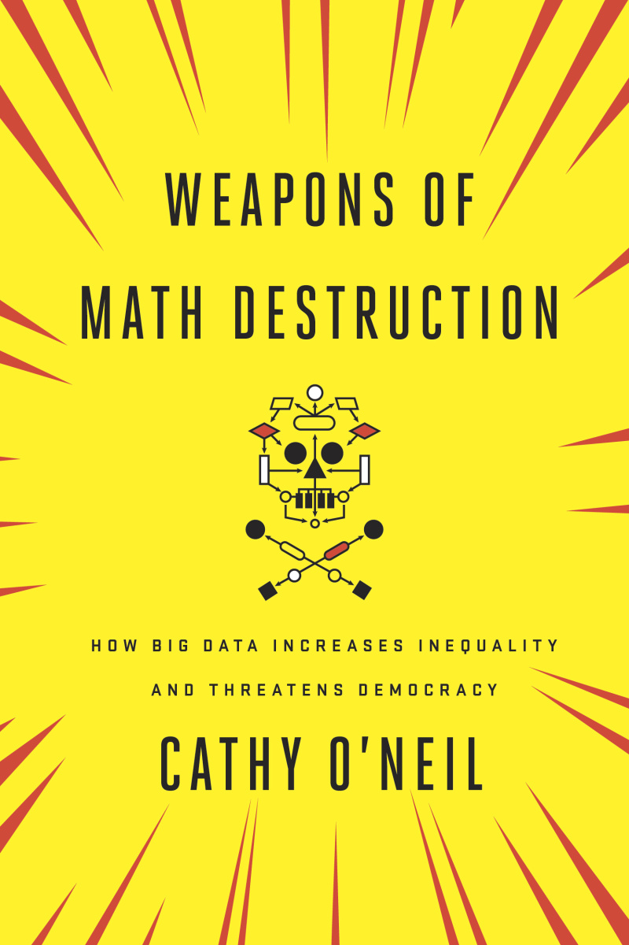
https://weaponsofmathdestructionbook.com/
Weapons of math destruction
“O’Neil’s book offers a frightening look at how algorithms are increasingly regulating people… Her knowledge of the power and risks of mathematical models, coupled with a gift for analogy, makes her one of the most valuable observers of the continuing weaponization of big data… [She] does a masterly job explaining the pervasiveness and risks of the algorithms that regulate our lives.” —New York Times Book Review
Cathy O’Neil
is a data scientist and author of the blog mathbabe.org. She earned a Ph.D. in mathematics from Harvard and taught at Barnard College before moving to the private sector, where she worked for the hedge fund D. E. Shaw. She then worked as a data scientist at various start-ups, building models that predict people’s purchases and clicks. O’Neil started the Lede Program in Data Journalism at Columbia and is the author of Doing Data Science. She is currently a columnist for Bloomberg View.

Slide 3
A model
We create a mathematical model, and let it run through data
Résumés, clicks, grades, …
This is unbiased, since the model doesn’t consider unrelated factors
Gender, skin color, prior education, …
But the model is made by the same fallible humans that said black people couldn’t sit in the front of the bus
And the models encode the prejudice, misunderstanding and bias into a seemingly objective, mathematical model
The book tells about bad models, and the harm they did and do
Notes:
People in this class who did BSO in their middle school? A model would have sent you to HBO5.

Slide 4
Why?
You will be the next generation of model-builders
This presentation is to make you think about what you will be creating, and the impact you will be having on actual real people
It’s not about discouraging the technological development

Slide 5
Schools in Washington
Washington D.C. in 2007, mayor Adrian Fenty wants to turn around the city’s underperforming schools
Education reformer Michelle Ree becomes chancellor of WDC schools
Theory: It’s the teachers fault
Stating from 2009: weed out the bad teachers
Created an assessment tool called IMPACT, and fire everyone in the bottom 2% procent the first year, bottom 5% the second year (206 teachers)
The model: value-added modeling
Measure the improvement of students on certain topics (math and language)
Counts for 50% of the overall score because it can be objectively measured
Bad teachers can seem good teachers, because they are friendly

Slide 6
Schools in Washington
Sarah Wysocki
Been teaching for 2 years
Excellent reviews from principal and student’s parents
Miserable IMPACT score: Fired
Why?
Nobody really knows how the model works, but the model is never wrong!
Complex because the socio-economic background of students and learning disabilities need to be taken into account
And it’s a mathematical formula. You can’t read or understand these without a PhD!

Slide 7
Sings of a WMD
Opacity
Is someone who is scrutinized by the WMD aware of this?
Can they look up the reasons why something happened to them?
Can someone explain why (they didn’t get a loan, they got fired, …)?
Scale
How widely are the models applied?
A model is usually created based on a subset of a population, but applied to the entire population
Damage
How many parts of your life will the WMD hurt?
Can ‘performing badly’ hurt the ones subjected to the test?
E.g. no loan and no job because of a bad credit score
https://www.youtube.com/watch?v=aRrDsbUdY_k

Slide 8
Schools in Washington
What happened to Sarah Wysocki?
Students starting the year had great scores on their test, but didn’t have the skills to back them
Sarah did her best to get them on a higher level, but the scores still looked like she had underachieved
And the teacher of the year before did great
Also, she had 30 students, which is not enough for a statistical approach
She quickly found a new job in a private school, making more money
The less privileged kids lost a good teacher, and kept a bad one

Slide 9


Slide 10

Moneyball
August, 1946, the Cleveland Indians
Ted Williams, playing the opposition, destroyed them
Three home runs, driven home eight
In the second game, Williams came on again
The Indians moved to the right
This is data science: Ted Williams usually hits to the right, so that’s where we will be standing
Now: different positions for every player
And also: record and grind all the data

Slide 11
Moneyball
The baseball case is not a WMD
Transparent:
Stats are publicly available
Everyone can understand how they are interpreted
Values are sometimes differently weighed, but never discarded
Feedback:
The effect of a change is measured by the same data
… and will be taken into account in the future
We are working with the actual data
We count the number of strikes to know how good they are at striking
We don’t look at skin colour to check the chance of robbing a liquor store
The model is constantly checked and improved

Slide 12
Prison
In America, it costs about 31,000$ to house an inmate for a year
$70 billion a year in total
We can cut down on this cost be reducing sentences
But only for inmates that won’t recidivate!
Solution: Recidivation models
Measure the current inmates chance of recidivation
Give this information to judges who determine length of sentence
One of the models: LSI-R (level of service inventory-revised)
A questionnaire for all inmates

Slide 13
LSI-R
Ok questions:
How many prior convictions have you had?
What part did others play in the offense?
What part did drugs and alcohol play?
Not ok questions:
The first time you were involved with the police?
Black and latino’s are 4.7% of New Yorks population, but 40.6% of stop-and-frisk subjects
A white kid carrying a joint gets away with it, a black kid won’t
Do you have friends or family with a criminal record?
Middle class: no, poor people in cheaper housing: yes
Asking for race would be illegal, but the question is unnecessary

Slide 14
The results of LSI-R
Judges: Seems like people with little chances in life are prone to recidivation. Let’s give them longer sentences.
Employers: This man did a long sentence. Let’s hire the one who did a shorter sentence.
The man: I need some food. Let’s rob a liquor store.
LSI-R: The man seems susceptible to recidivism. Better suggest longer prison sentences for everyone like him.
E.I. longer sentences are bad in country notoriously bad with re-entry
https://www.youtube.com/watch?v=gJtYRxH5G2k

Slide 15
LSI-R
The LSI-R doesn’t judge who you are, but where you come from
In some states the results are only used while in prison
For anti-recidivism programs
But in others, it’s used to determine the length of the sentence, which is illegal
You can’t give someone a longer prison sentence because they are black, but you can give someone a longer prison sentence because they live among blacks?
But you can’t argue with a mathematical model…

Slide 16
Baseball vs LSI-R
The baseball model was a good model
You measure what you want to know (strikes and catches)
You refine the model based on actual data (we didn’t catch the ball moving left, so lets not move right and see what happens)
The stats are open and can be discussed
The LSI-R was a bad model
You measure proxies (where someone lives vs if they’re robbing liquor stores)
You refine the model based on the outcome of the model (if we keep people of type A in prison longer, people of type A are associated with criminals more)
Prisoners know what the questionnaire is for, but never get their ‘results’

Slide 17
School ranking
1983, U.S. New & World, a struggling magazine makes a report: Evaluate all 1.800 colleges and universities and rank them
Would help millions in choosing a college
But what information shall we use?
In the beginning, surveys by the university presidents
But that’s unfair, so they started looking at the data
But how to measure “educational excellence”
You can’t measure learning, happiness, confidence of friendships, …

Slide 18
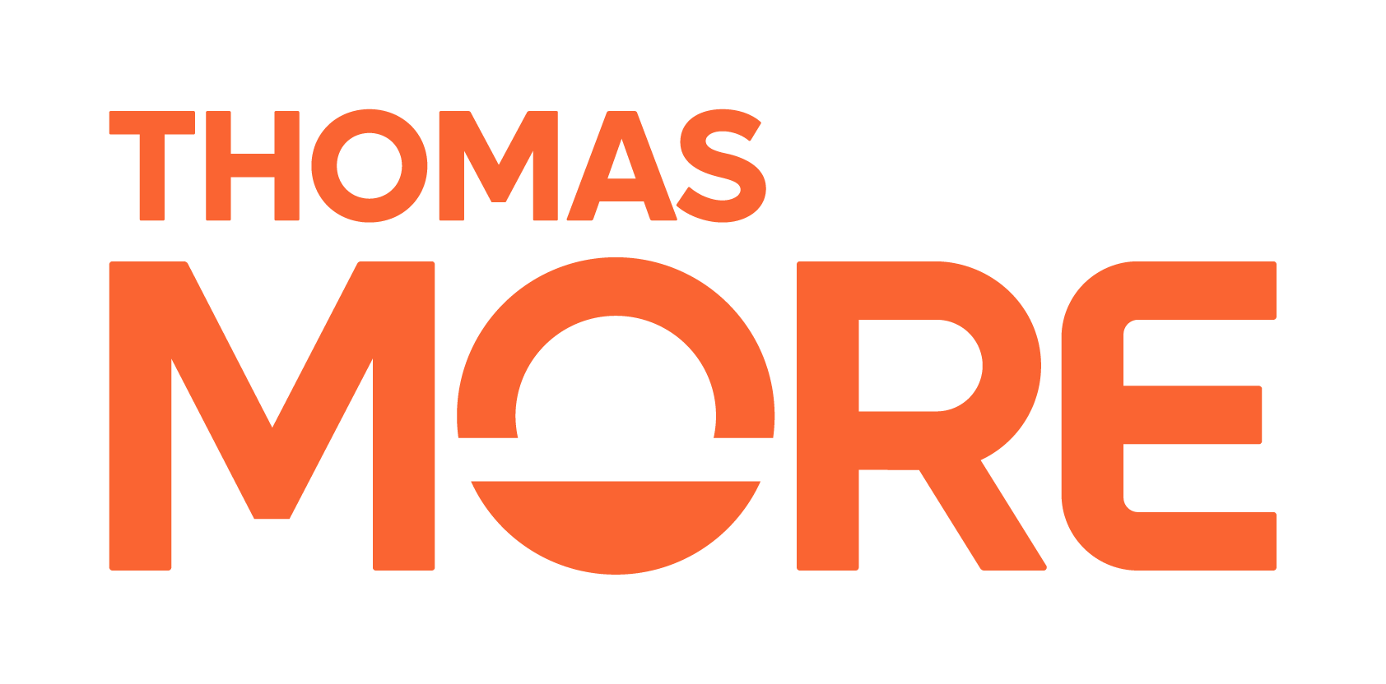
School ranking
So proxies were chosen
SAT-score, student-teacher ratios, acceptance rates
Percentage of starting vs finishing students
Percentage of alumni donating money
The proxies are driven through a model
Results came in 1988, and seemed fine
But would you (the elite) choose for a sub-optimal college?
Off course not!

Slide 19
School ranking
A school scoring badly
Loses promising students
Loses top professors
Alumni are unsatisfied and stop donating
And their scores drop even further…
Schools, instead of developing their strong points, now develop their ranking scores
Baylor University: paying students to retake SAT
Bucknell and Claremont McKenna: send fake SAT scores
Iona: fake numbers about everything

Slide 20
School ranking
In 2008, Texas Christian University was improving, but the score was going doing down
It’s a ranking, and if everybody rises, you have to rise faster
So, TCU launched a fund raiser, and got $434 million
They started to increase their rating
Campus improvement (boosts the ranking)
Money into the football program
Which got them a great football season
Which meant applications went up by 30%
Which meant they could be more selective in selecting applicants
Which meant they got better SAT scores and rose 37 places

Slide 21
School ranking
What TCU did was a good thing
The school actually became better by trying to rise in the ranking
The proxies are good, measuring “learning” quite accurately
The problem is that all schools are ranked the same
A student with a bad SAT score is ‘bad credit’
No schools want them, only the very worst
Also, tuition and fees are not calculated
Because if they did, Harvard, Stanford and Princeton wouldn’t have been first, and nobody would have cared for the ranking
Meaning colleges can charge whatever, as long as they rank highly

Slide 22
School ranking
From 1985 to 2013, the cost of higher education has risen 500%
4 times inflation
Schools look great now
Glass-walled student centres, gyms with climbing walls, whirlpool baths
But students graduate with student loans that will burden them for decades
Also: companies have arisen that help colleges pick their students
Some athletes, some rich students, some students with learning disabilities

Slide 23
School rankings
https://www.collegeconsensus.com/rankings/best-college-admissions-consultants/

Slide 24

School rankings
These are companies that specialize in ‘getting students into schools’
They have reverse engineered the system schools use to get a high ranking, and apply that to students wanting to get into those schools
It offers guaranteed consulting packages
This reduces the qualifications for top universities to ‘being rich’
Or a good athlete
Notes:
https://www.xkcd.com/2215/

Slide 25
School rankings: the solution
Are school rankings a bad thing? Yes and no
No:
Students need to know about the bad schools
And this information is hard to come by
Yes:
There is no one ranking, every school has its strong and weak points
Some students need school A, others school B
Some companies will hire from school A, others from school B
The best school is the school that best suits your needs
We need to provide honest and objective information on schools, not summarize this information in one single ranking

Slide 26


School laptop rankings
HP Omen
Great graphics
Big display
2 HD’s
Weighs 2,23 kg
Dell XPS 13
Good graphics
Medium sized display
Fast HD
Weighs 1,17 kg

Slide 27

Het nieuwsblad, 17-3-2023
School rankings
Flemish minister for education Ben Weyts: good idea
Educationalist Pedro De Bruyckere: beware of the problems

Slide 28
New verb: Clopening
Closing (in the evening) and opening a store or bar (the following morning)
Not popular among employees
Happens often with low-wage jobs in companies like McDonalds, Starbucks, …

Slide 29

Scheduling: the old days
Clerks work 9 to 5, six days a week
Problem: Tuesday mornings are really slow and Saturdays are very busy
Solution: on Tuesday morning only the owner is there, on Saturday you hire an additional student
Notes:
http://www.mhzvervoort.be/

Slide 30
Scheduling: now
Bluetooth-receptors and analysis of security-cam footage: companies know who is there when, and for what
Include external data: weather reports, pedestrian patterns, seasonal changes, …
Schedules of employees are changed accordingly
And fast, sometimes you don’t know a week in advance when you’ll be working

Slide 31
Scheduling
In 2014, the New York Times ran an article on Janette Navarro
Has a four year old kid, is a student in college, is working at starbucks
But, scheduling was hard
Day-care was impossible
School was difficult to plan
Result: she dropped out of school (the only thing she could stop)
US Government data:
2/3 of food service workers and nearly ½ of retail workers find out about schedule changes less than a week in advance

Slide 32
Scheduling
Embarrassed, major corporations vowed to eliminate clopenings and all work hours would be posted at least a week in advance
A year later, this still wasn’t the case
The problem: minimal staffing was in the culture of these companies
The pay of the manager depends on the efficiency of the staff
Measured in revenue per employee hour
Scheduling software helps boost these numbers (and their bonus)
Discipline of mathematics called Operations Research (OR)
Started in World War II, comparing resources spent vs enemies destroyed

Slide 33

The grapes of Wrath (John Steinbeck)
During the great depression, farmers from California send pamphlets to Oklahoma where thousands of workers are without a job
They only need a certain number of workers, but the tenfold shows up
This provides the Californians with very cheap labour
And famine and starvation among the Okies
It’s a great book, you should read it
Notes:
https://en.wikipedia.org/wiki/The_Grapes_of_Wrath

Slide 34
Scheduling
Starbucks can push an employee to the limit, but not over it
Replacing them costs money
But the employee won’t go working for McDonalds, because it’s just as bad over there
It’s a WMD…
Opaque: You don’t know why you have to work 16 hours on Monday and none on Thursday, it’s just the way it is (this week, next week is different)
Scale: It’s widespread among all low-paying jobs (at big corporations)
Damage: Needing a job like this will affect your personal life

Slide 35
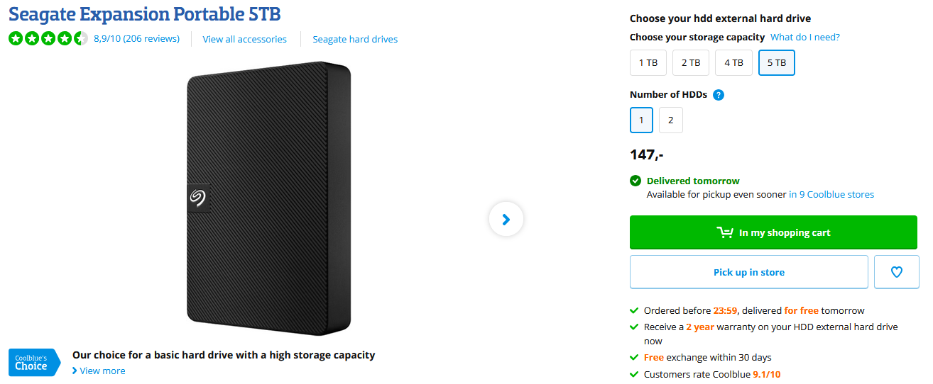
How do you think the schedule is for the people who make “Ordered before 23:59, delivered for free tomorrow” come true?

Slide 36
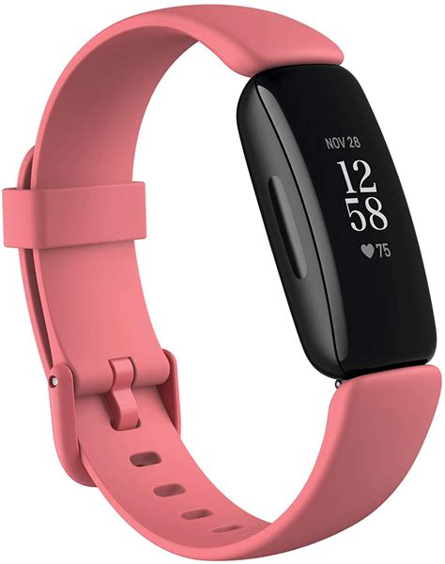
We need some data
Since this course is focused on data, we’ll be creating our own dataset
If you fill in your favorite color in the assignment on Canvas you’ll get a fitbit next week in that color
We got a sponsor, so it’s free!
We’ll all be wearing these and sharing our information with each other

Slide 37
Sharing all our data
The rule for getting a free fitbit is that you have to wear it at all times
When you are sleeping, studying, commuting, eating, watching TV, going on a date, …
When paired with your results in the group work we’ll be able to answer some interesting questions:
Is more sleep better for your grades?
Are we eating healthy?
Who is working hard and who is only committing to Github?
What is the average success rate of a date in this group?
Is dating a lot nefarious for your study results?

Slide 38

Notes:
Previous slide is the gist of this book. It goes further than that. But it is actually a sequel to…

Slide 39
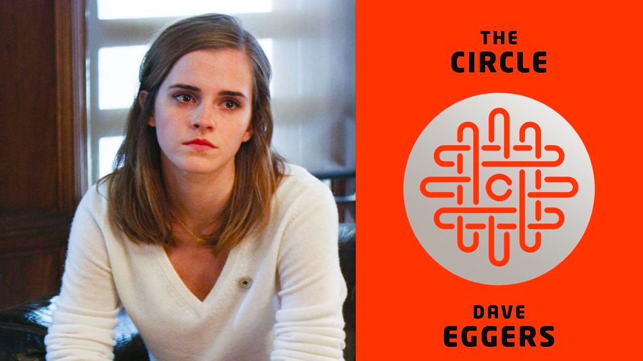

Slide 40
The circle
The circle is also a book
A good book actually, pretty unnerving
You should read it
The circle is about a company equivalent to google and facebook combined
They get rich from advertising, but spend money this to improve life for mankind
I.E. chipping every kid in their bones to make abductions impossible
The downside being that the chip stays there when they grow up, and the circle knows where everyone is all the time
But how real is the book?
Notes:
https://en.wikipedia.org/wiki/The_Circle_(Eggers_novel)

Slide 41
Facebook and voting
Facebook employs researchers that are living the researchers dream
Not: working with test group
But: testing stuff on everyone
A publicly documented experiment: getting people to vote
Put a button ‘I voted’ on people’s pages
When it was clicked, this was posted to friends who hadn’t voted, and felt the pear pressure building

Slide 42
Facebook and voting
Your timeline is generated by an algorithm
By tweaking this algorithm, they can make sure ‘hard’ news shows up higher on your list
Mind, Facebook only show this when a friend has posted it first
But given enough friends, that’s not really a problem
Facebook experimented with this during the Obama vs Romney
After the elections, they compared surveys sent to the users
People wo got more hard news participated more in 3% of the cases
On 61 million users in the US, that’s a lot of people

Slide 43
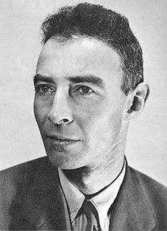
J. Robert Oppenheimer
When you see something that is technically sweet, you go ahead and do it and you argue about what to do about it only after you have had your technical success. That is the way it was with the atomic bomb.

Slide 44
But maybe
… that last slide is making it look worse than it actually is…

